Slide 1

To-Do List Web Page
Ibraheem Latif

Slide 2

Introduction
Create an Object Oriented Programming (OOP) web application.
Full CRUD functionality
Local and online Database
Testing coverage of 80%
A complied application
Notes:
Who are you? How did you approach the specification?

Slide 3
Concept
Three-tier architectural structure:
  Data
  Business
  Presentation
Notes:
How did I initially approach the problem

Slide 4
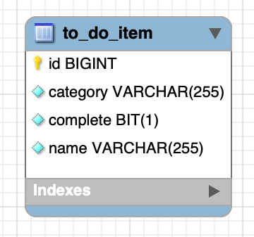
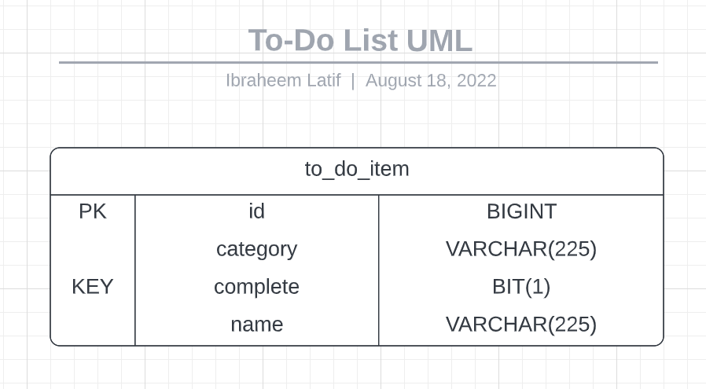
Data Layer

Slide 5
Business Layer
Business (API) Layer
Entity
Controller
Service
Repo

Slide 6
Sprint Plan
Sprint 1
  Documentation
  API
Start Date
15/08/2022 – 9:00AM
End Date
16/08/2022 – 12:00AM
Sprint 2
  Web Page Creation
  Testing
Start Date
16/08/2022 – 12:30AM
End Date
17/08/2022 – 12:00AM
Sprint 3
  Presentation
  Compile
Start Date
17/08/2022 – 12:30AM
End Date
18/08/2022 – 17:00PM
Notes:
What needed to be included? What did I hope to achieve?
Three sprints, each had their own goal.
First goal was to complete API
Second Front end and testing
Third presentation and final user check

Slide 7
Journey
Technology | Description
JavaScript | Creation of interactive webpages
CSS | Used to style elements on HTML documents
HTML | Used to structure webpages
Spring Boot | Application used to fast track creation of services with their frameworks
VS Code | IDE
Swagger | Creates documentation for API’s
Notes:
What technologies have I learned in this project

Slide 8
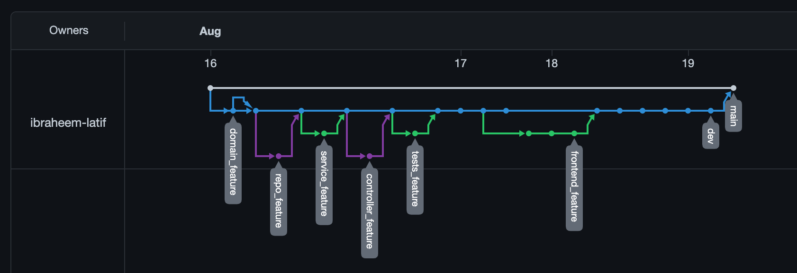
Continuous Integration
Version control system
  Git
  Github
When MVP was being developed, the feature branch approach was employed to ensure that it was always functional for users
Branches were called by the thought that they change.
Notes:
How did I approach version control?
Followed the master/dev/feature model

Slide 9
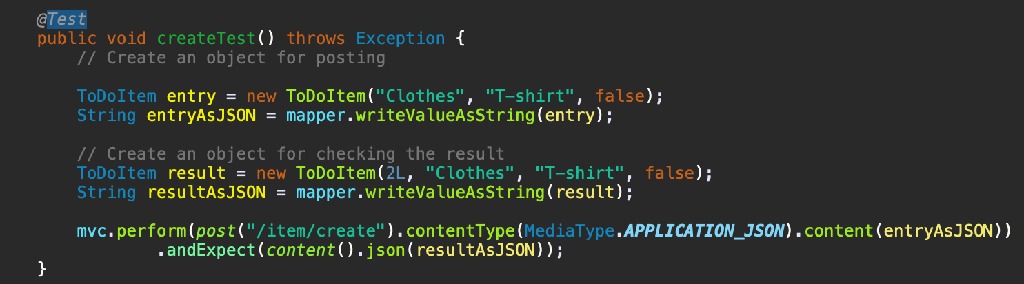
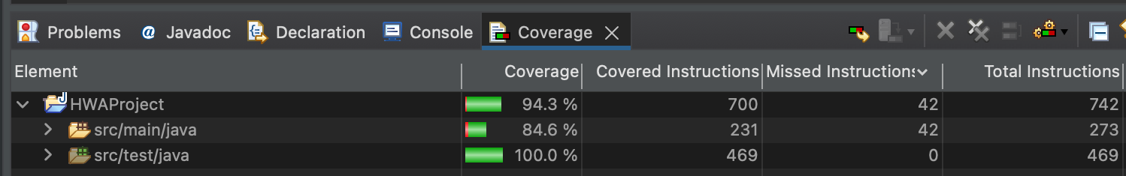
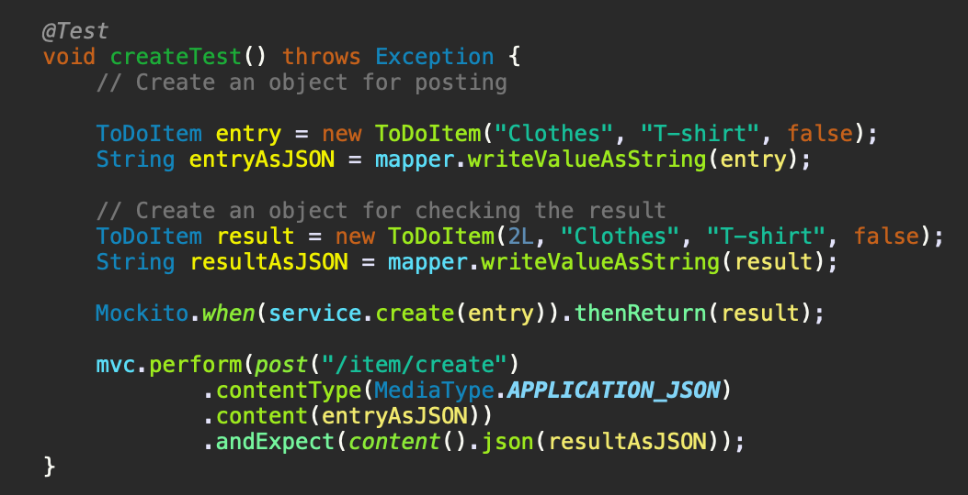
Testing
Integration Testing
Unit Testing
Notes:
Coverage, static analysis, red-green-refactor

Slide 10
Demonstration
Notes:
Run through a couple user stories

Slide 11
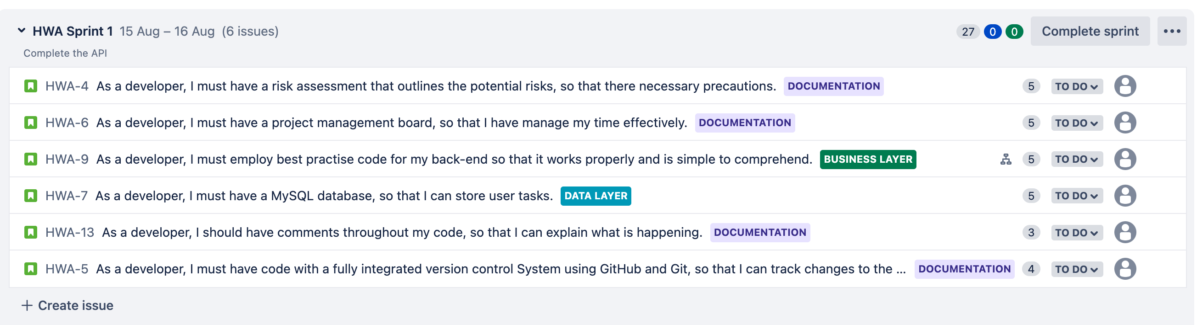
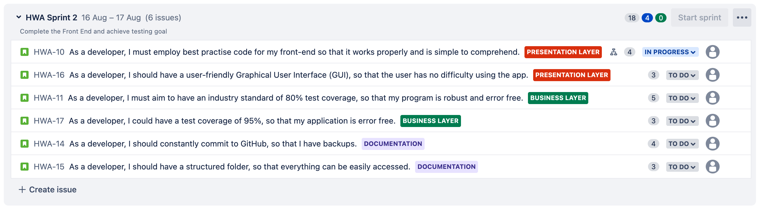
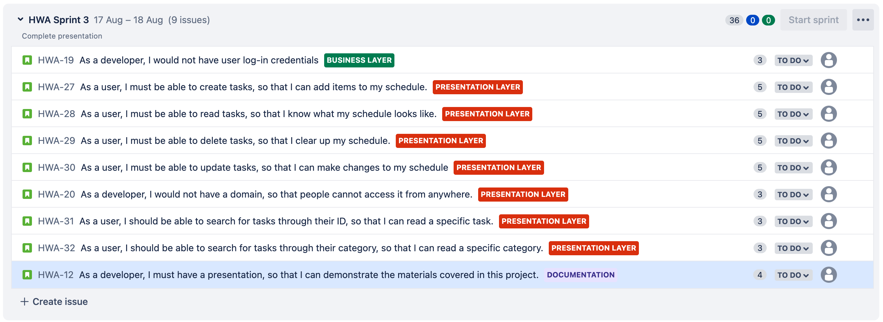
Sprint Review
Notes:
What needed to be included? What did I hope to achieve?
Three sprints, each had their own goal.
First goal was to complete API
Second Front end and testing
Third presentation and final user check

Slide 12
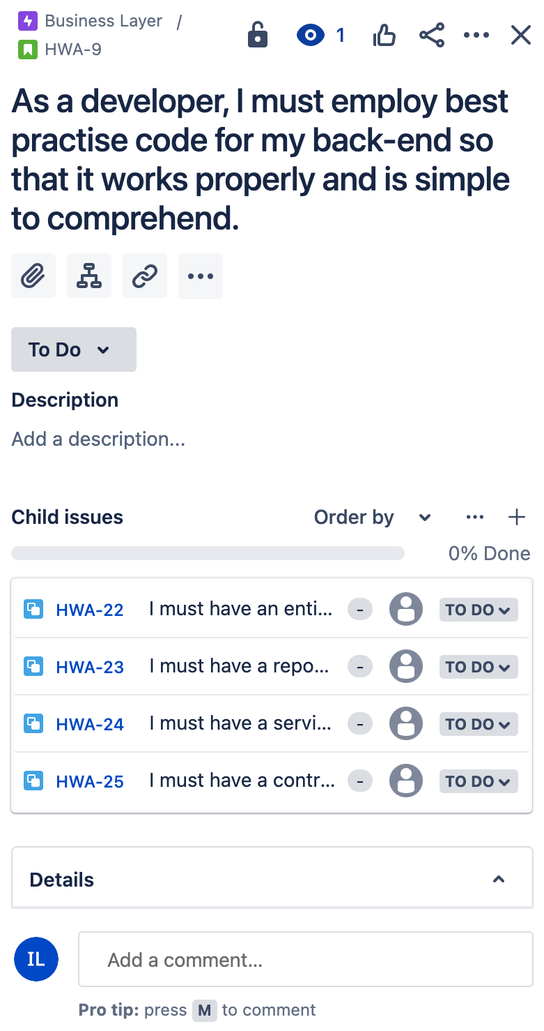
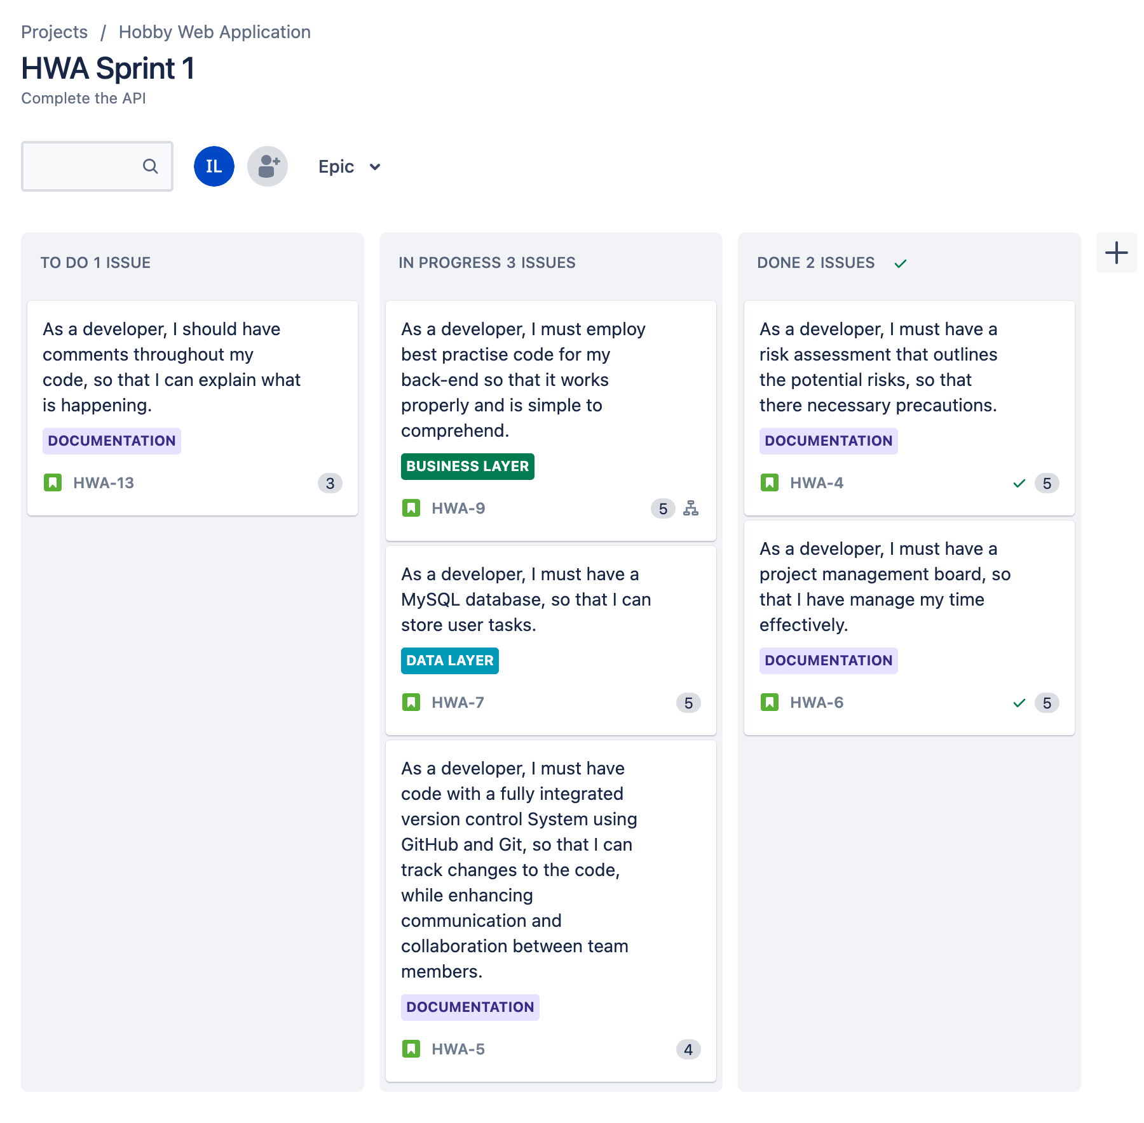
Sprint One Example

Slide 13
Sprint Retrospective
What went well?
Suitable epics
MVP achieved
Use of MoSCoW
What could be improved?
Included more topics (Child issues)
Use Jira to highlight bugs in project
Time management
  Extra time to make the web page user friendly
Notes:
What went well? What could be improved?

Slide 14

Conclusion & Future Work
The web application meets the MVP.
Developed knowledge on Swagger API.
Create a user friendly web page.
Notes:
Reflections on the project, future steps other relevant info

